Slide 1


Security+
Exam SY0-601
Chapter 25
Public Key Infrastructure
Notes:
Gain Attention

Slide 2
Chapter 25 (Domain 3.9) Learning Objectives
Implement public key infrastructure.
Public Key Infrastructure (PKI)
Key management
Certificate Authority (CA)
Intermediate CA
Registration Authority (RA)
Certificate Revocation List (CRL)
Certificate attributes
Online Certificate Status Protocol (OCSP)
Certificate Signing Request (CSR)
Common Name (CN)
Subject Alternative Name (SAN)
Expiration
Types of certificates
Wildcard
Subject Alternative Name
Code Signing
Self-signed
Machine/computer
Email
User
Root
Domain validation
Extended validation

Slide 3
Chapter 25 (Domain 3.9) Learning Objectives
Implement public key infrastructure.
Certificate formats
Distinguished Encoding Rules (DER)
Privacy Enhanced Mail (PEM)
Personal Information Exchange (PFX)
.cer
P12
P7B
Concepts
Online vs offline CA
Stapling
Pinning
Trust model
Key escrow
Certificate chaining

Slide 4
Public Key Infrastructure (PKI)
A Public Key Infrastructure (PKI) provides all the components necessary for different types of users and entities to be able to communicate securely and in a predictable manner.
A PKI is made up of hardware, applications, policies, services, programming interfaces, cryptographic algorithms, protocols, users, and utilities.
These components work together to allow communication to manage asymmetric keys facilitating the use of public key cryptography for digital signatures, data encryption, and integrity.
Helps prevent Man-in-the-Middle attacks.

Slide 5
Public Key Infrastructure (PKI)
Registration Authority (RA)
The RA will require proof of identity from the individual requesting a certificate and will validate this information.
The RA will then advise the CA to generate a certificate.
Certificate Authority (CA)
The CA will digitally sign the certificate using its private key.
The use of the private key assures the recipient that the certificate came from the CA.

Slide 6
Public Key Infrastructure (PKI)
A registration authority (RA) verifies digital certificate requests and forwards them to a certificate authority (CA).
The CA is a trusted organization that validates and issues digital certificates.
This is commonly referred to as a third-party trust model.
The environment that the infrastructure provides allows these higher-level applications to communicate with each other and gives them the underlying tools to carry out their tasks.

Slide 7
Key Management
The whole purpose for PKI is to provide the structure and components necessary for an organization to manage cryptographic keys that need to be shared between entities.
A digital key is just a digital number, simply data.
Metadata elements about the keys—who made them, what they are used for, how long they are valid, and a host of other questions—need to be stored with the key.
Digital certificate: a simple text file that contains vital information about a key.
Other important elements surrounding key management include policies on key protection, storage, key escrow, and key recovery.

Slide 8
Certificate Authority (CA)
The Certificate Authority (CA) is the trusted authority that certifies individuals’ identities and creates electronic documents indicating that individuals are who they say they are.
The electronic document is referred to as a digital certificate, and it establishes an association between the subject’s identity and a public key.
The private key that is paired with the public key in the certificate is stored separately.

Slide 9
Certificate Authority (CA)
The CA is more than just a piece of software, however; it is actually made up of the software, hardware, procedures, policies, and people involved in validating individuals’ identities and generating the certificates.
This means that if one of these components is compromised, it can negatively affect the CA overall and can threaten the integrity of the certificates it produces.

Slide 10
Certificate Authority (CA)
Every CA should have a certification practices statement (CPS) that outlines how identities are verified; the steps the CA follows to generate, maintain, and transmit certificates; and why the CA can be trusted to fulfill its responsibilities.
It describes how keys are secured, what data is placed within a digital certificate, and how revocations will be handled.
A critical aspect of a PKI is the trust between the users and the CA, so the CPS should be reviewed and understood to ensure that this level of trust is warranted.

Slide 11
Certificate Authority (CA)
The certificate server is the actual service that issues certificates based on the data provided during the initial registration process.
The server constructs and populates the digital certificate with the necessary information and combines the user’s public key with the resulting certificate.
The certificate is then digitally signed with the CA’s private key.

Slide 12
Intermediate CA
Intermediate CAs function to transfer trust between different CAs.
These CAs are also referred to as subordinate CAs because they are subordinate to the CA that they reference.
The path of trust is walked up from the subordinate CA to the higher-level CA; in essence, the subordinate CA is using the higher-level CA as a reference.

Slide 13
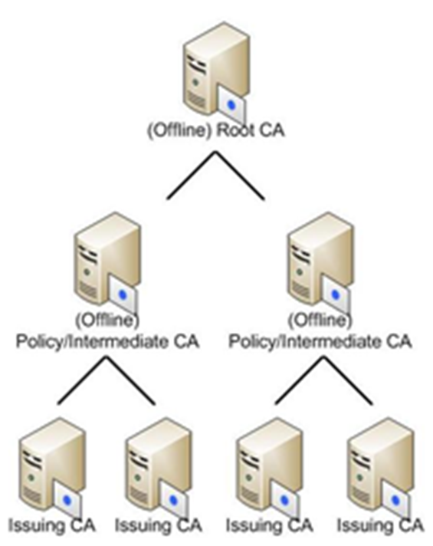
CA Hierarchy

Slide 14
Registration Authority (RA)
A Registration Authority (RA) is the PKI component that accepts a request for a digital certificate and performs the necessary steps of registering and authenticating the person requesting the certificate.
The authentication requirements differ depending on the type of certificate being requested.
Most CAs offer a series of classes of certificates with increasing trust by class.
Each higher class of certificate can carry out more powerful and critical tasks than the one below it.

Slide 15
Classes of certificates
Class 1
You may only be asked to provide your name, e-mail address, and physical address.
Class 2
You may need to provide the RA with more data, such as your driver’s license, passport, and company information that can be verified.
Class 3
You will be asked to provide even more information and most likely will need to go to the RA’s office for a face-to-face meeting.

Slide 16
Certificate Revocation List (CRL)
The CA provides protection against bad certificates by maintaining a Certificate Revocation List (CRL), a list of serial numbers of certificates that have been revoked.
The CRL also contains a statement indicating why the individual certificates were revoked and a date when the revocation took place.
The list usually contains all certificates that have been revoked within the lifetime of the CA.
Certificates that have expired are not the same as those that have been revoked. If a certificate has expired, it means that its end validity date was reached.

Slide 17
Certificate Revocation List (CRL)
The CA is the entity responsible for the status of the certificates it generates; it needs to be told of a revocation, and it must provide this information to others.
The CA is responsible for maintaining the CRL and posting it in a publicly available directory.
The certificate revocation list is an essential item to ensure a certificate is still valid.
The CRL’s integrity needs to be protected to ensure that attackers cannot modify data pertaining to a revoked certification from the list.
The only entity that should be able to modify any information on the CRL is the CA.

Slide 18
Certificate Revocation List (CRL)
The mechanism used to protect the integrity of a CRL is a digital signature.
The CA’s revocation service creates a digital signature for the CRL.
To validate a certificate, the user accesses the directory where the CRL is posted, downloads the list, and verifies the CA’s digital signature to ensure that the proper authority signed the list and to ensure that the list was not modified in an unauthorized manner.
The user then looks through the list to determine whether the serial number of the certificate that he is trying to validate is listed.
If the serial number is on the list, the private key should no longer be trusted, and the public key should no longer be used.

Slide 19
Certificate Revocation List (CRL)
One concern is how up to date the CRL is—how often is it updated, and does it actually reflect all the certificates currently revoked?
The actual frequency with which the list is updated depends on the CA and its CPS.
It is important that the list is updated in a timely manner so that anyone using the list has the most current information.
One last option for checking distributed CRLs is an online service.
When a client user needs to validate a certificate and ensure that it has not been revoked, he can communicate with an online service that will query the necessary CRLs available within the environment.

Slide 20
Certificate Attributes
A digital certificate binds an individual’s identity to a public key, and it contains all the information a receiver needs to be assured of the identity of the public key owner.
The certificates are created and formatted based on the X.509 standard, which outlines the necessary fields of a certificate and the possible values that can be inserted into the fields.

Slide 21
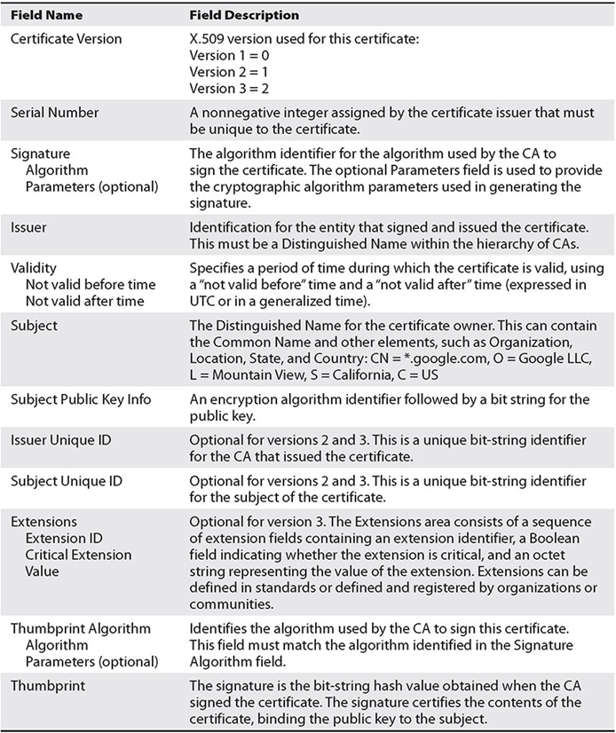
Certificate Attributes

Slide 22
Online Certificate Status Protocol (OCSP)
One of the protocols used for online revocation services is the Online Certificate Status Protocol (OCSP), a request and response protocol that obtains the serial number of the certificate that is being validated and reviews CRLs for the client.
The protocol has a responder service that reports the status of the certificate back to the client, indicating whether it has been revoked, it is valid, or its status is unknown.
This protocol and service save the client from having to find, download, and process the right lists.

Slide 23
Certificate Signing Request (CSR)
A Certificate Signing Request (CSR) is the actual request to a CA containing a public key and the requisite information needed to generate a certificate.
The CSR contains all the identifying information that is to be bound to the key by the certificate-generation process.

Slide 24
Common Name (CN)
The Common Name (CN) field is represented in the Subject field of the certificate and is the fully qualified domain name (FQDN) for which the certificate is valid.
A common representation in the subject line of a certificate may contain the Common Name and other elements, such as Organization, Location, State, and Country:
CN = *.google.com,
O = Google LLC,
L = Mountain View,
S = California,
C = US.
The O is organization, L is location, S is state, and C is country.

Slide 25
Distinguished Name (DN)
Distinguished Name (DN) is a term that describes the identifying information in a certificate and is part of the certificate itself.
A certificate contains DN information for both the owner or requestor of the certificate (called the Subject DN) and the CA that issues the certificate (called the Issuer DN).

Slide 26
Subject Alternative Name (SAN)
Subject Alternative Name (SAN) is a field (extension) in a certificate that has several uses.
In certificates for machines, it can represent the FQDN of the machine.
For users, it can be the user principal name (UPN) or, in the case of an SSL certificate, it can indicate multiple domains across which the certificate is valid.
Figure 25-4 shows the multiple domains covered by the certificate in the box below the field details.
SAN is an extension that is used to a significant degree, as it has become a standard method used in a variety of circumstances.

Slide 27
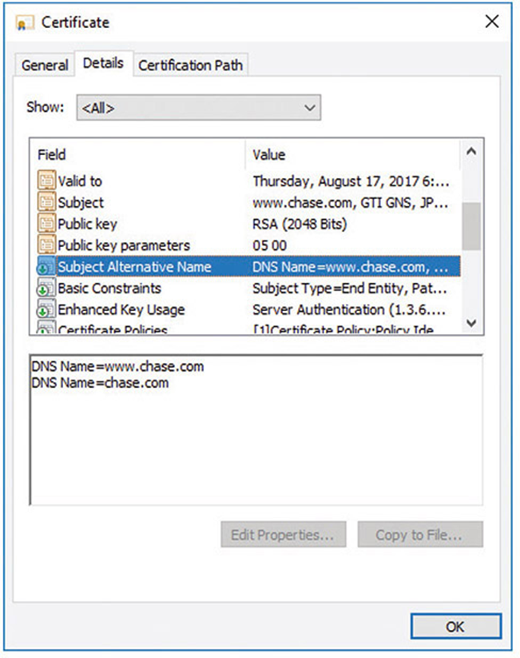
Subject Alternative Name (SAN)

Slide 28
Subject Alternative Name (SAN)
SAN certificates allow you to secure a primary domain and then add additional domains to the Subject Alternative Name field of the certificate.
For example, you can secure all these domains with a single SAN certificate:
www.example.com
email.example.com
intranet.example.com
www.example.net

Slide 29
Expiration
A certificate itself has a lifetime that can be different from the key pair’s lifetime.
The certificate’s lifetime is specified by the validity dates inserted into the digital certificate.
These are beginning and ending dates indicating the time period during which the certificate is valid.
The certificate cannot be used before the start date, and once the end date is met, the certificate is expired and a new certificate will need to be issued.

Slide 30
Types of Certificates
Four main types of certificates are used:
End-entity certificates
Issued by a CA to a specific subject, such as Joyce, the Accounting department, or a firewall
CA certificates
A CA certificate can be self-signed, in the case of a stand-alone or root CA, or it can be issued by a superior CA within a hierarchical model.
Cross-certification certificates
Cross-certification certificates, or cross-certificates, are used when independent CAs establish peer-to-peer trust relationships.
Policy certificates
A mechanism to provide centrally controlled policy information to PKI clients.

Slide 31
Wildcard Certificates
Certificates can be issued to an entity such as example.com.
But what if there are multiple entities under example.com that need certificates?
There are two choices: issue distinct certificates for each specific address or use wildcard certificates.
Wildcard certificates work exactly as one would expect.
A certificate issued for *.example.com would be valid for one.example.com as well as two.example.com.
Wildcard certificates include an asterisk and period before the domain name.
SSL certificates commonly extend encryption to subdomains through the use of wildcards.

Slide 32
Subject Alternative Name (SAN)
Subject Alternative Name (SAN) is a field (extension) in a certificate that has several uses. In certificates for machines, it can represent the fully qualified domain name (FQDN) of the machine; for users, it can be the user principal name (UPN).
In the case of an SSL certificate, it can indicate multiple domains across which the certificate is valid.
SAN is an extension that is used to a significant degree because it has become a standard method used in a variety of circumstances.

Slide 33
Code-Signing Certificates
Certificates can be designated for specific purposes, such as code signing.
This is to enable the flexibility of managing certificates for specific functions and to reduce the risk in the event of compromise.
Code-signing certificates are designated as such in the certificate itself, and the application that uses the certificate adheres to this policy restriction to ensure proper certificate usage.

Slide 34
Self-Signed Certificates
Certificates are signed by a higher-level CA, providing a root of trust.
As with all chains, there is a final node of trust: the root node.
Not all certificates have to have the same root node.
A company can create its own certificate chain for use inside the company, and thus it creates its own root node.

Slide 35
Machine/Computer
Certificates bind identities to keys and provide a means of authentication, which at times is needed for computers.
Active Directory Domain Services (AD DS) can keep track of machines in a system via machines identifying themselves using machine certificates, also known as computer certificates.
When a user logs in, the system can use either the machine certificate, identifying the machine, or the user certificate, identifying the user—whichever is appropriate for the desired operation.
This is an example of an end-entity certificate.

Slide 36
E-mail
Digital certificates can be used with e-mail systems for items such as digital signatures associated with e-mails.
Just as other specialized functions such as code signing have their own certificates, it is common for a separate e-mail certificate to be used for identity associated with e-mail.
This is an example of an end-entity certificate.

Slide 37
User
User certificates are just that—certificates that identify a user.
They are an example of an end-entity certificate.
User certificates are employed by users for encrypted file systems (EFS), e-mail, and client authentications, whereas computer certificates help computers to authenticate to the network.

Slide 38
Root
A root certificate is a certificate that forms the initial basis of trust in a trust chain.
All certificates are signed by the CA that issues them, and CAs can be chained together in a trust structure.
Following the chain, one climbs the tree of trust until they find a self-signed certificate, indicating it is a root certificate.
What determines whether or not a system trusts a root certificate is whether or not the root certificate is in the system’s store of trusted certificates.

Slide 39
Domain Validation
Domain validation is a low-trust means of validation based on an applicant demonstrating control over a DNS domain.
Domain validation is typically used for TLS and has the advantage that it can be automated via checks against a DNS record.
A domain validation–based certificate, which is typically free, offers very little in assurance that the identity has not been spoofed because the applicant doesn’t need to directly interact with the issuer.
Domain validation scales well and can be automated with little to no real interaction between an applicant and the CA, but in return it offers little assurance.
Domain validation is indicated differently in different browsers, primarily to separate it from extended validation certificates, described next.

Slide 40
Extended Validation
Extended validation (EV) certificates are used for HTTPS websites and software to provide a high level of assurance as to the originator’s identity.
EV certificates use the same methods of encryption to protect certificate integrity as do domain- and organization-validated certificates.
The difference in assurance comes from the processes used by a CA to validate an entity’s legal identity before issuance.
Because of the additional information used during the validation, EV certificates display the legal identity and other legal information as part of the certificate.
EV certificates support multiple domains, but do not support wildcards.

Slide 41
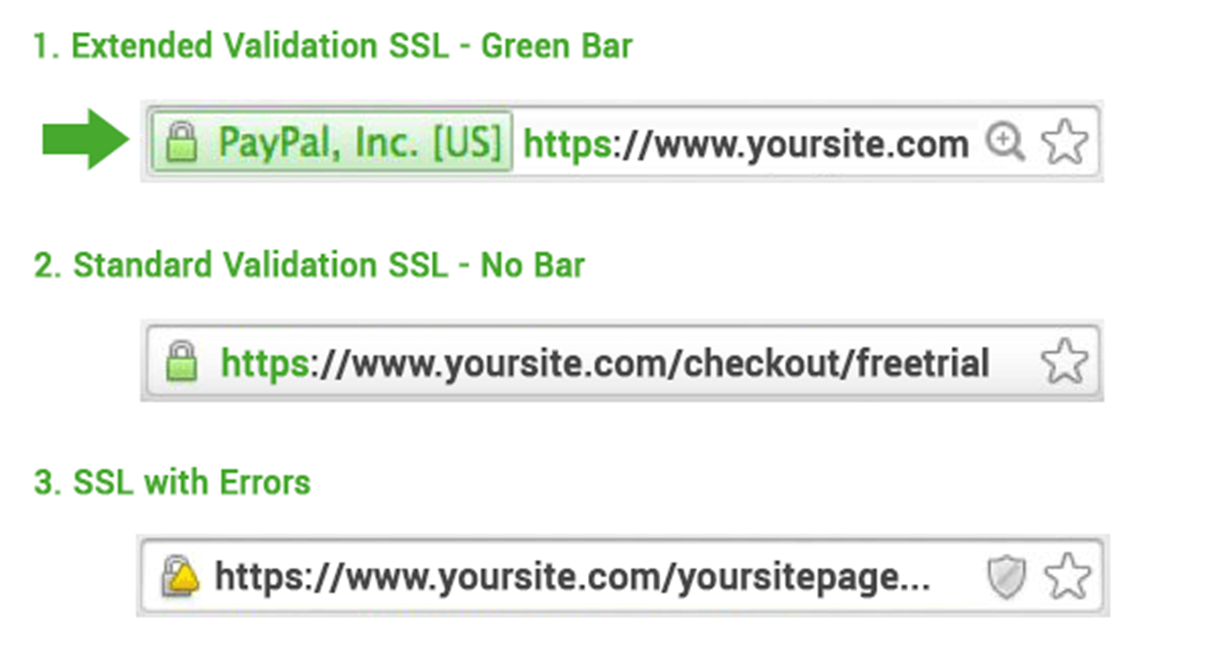
Extended Validation

Slide 42
Certificate Formats
Digital certificates are defined in RFC 5280: Internet X.509 Public Key Infrastructure Certificate and Certificate Revocation List (CRL) Profile.
This RFC describes the X.509 v3 digital certificate format in detail.
There are numerous ways to encode the information in a certificate before instantiation as a file, and the different methods result in different file extensions.
Common extensions include .der, .pem, .crt, .cer, .pfx, .p12, and .p7b. Although they all can contain certificate information, they are not all directly interchangeable.
While in certain cases some data can be interchanged, the best practice is to identify how your certificate is encoded and then label it correctly.

Slide 43
KEY
A KEY file, denoted by the file extension .key, can be used both for public and private PKCS#8 keys.
The keys may be encoded as binary DER or as ASCII PEM.

Slide 44
Distinguished Encoding Rules (DER)
Distinguished Encoding Rules (DER) is one of the Abstract Syntax Notation One (ASN.1) encoding rules that can be used to encode any data object into a binary file.
With respect to certificates, the data associated with the certificate, a series of name-value pairs, needs to be converted to a consistent format for digital signing.
DER offers a consistent mechanism for this task.
A DER file (.der extension) contains binary data and can be used for a single certificate.

Slide 45
Privacy-Enhanced Mail (PEM)
Privacy-Enhanced Mail (PEM) is the most common format used by certificate authorities when issuing certificates.
PEM comes from RFC 1422 and is a Base64-encoded ASCII file that begins with “-----BEGIN CERTIFICATE-----”, followed by the Base64 data, and ends with “-----END CERTIFICATE-----”.
A PEM file supports multiple digital certificates, including a certificate chain.
A PEM file can contain multiple entries, one after another, and can include both public and private keys.
Most platforms, however, such as web servers, expect the certificates and private keys to be in separate files.
The PEM format for certificate data is used in multiple file types, including .pem, .cer, .crt, and .key files.

Slide 46
Personal Information Exchange (PFX)
A PKCS#12 file is a portable file format with a .pfx extension.
It is a binary format for storing the server certificate, intermediate certificates, and the private key in one file.
Personal Information Exchange (PFX) files are typically used on Windows machines to import and export certificates and private keys.

Slide 47
CER
The .cer file extension is used to denote an alternative form, from Microsoft, of CRT files.
The .cer/.crt extension is used for certificates and may be encoded as binary DER or as ASCII PEM.
The .cer and .crt extensions are nearly synonymous.
The .cer extension is most commonly associated with Microsoft Windows systems, whereas .crt is associated with UNIX systems.
The file extension .cer is an SSL certificate file format used by web servers to help verify the identity and security of the site in question.

Slide 48
P12
P12 is an alternative file extension for a PKCS#12 file format, a binary format for storing the server certificate, intermediate certificates, and the private key in one encrypted file.
These files usually have an extensions such as .pfx or .p12.
They are typically used on Windows machines to import and export certificates and private keys.

Slide 49
P7B
The PKCS#7 or P7B format is stored in Base64 ASCII format and has a file extension of .p7b or .p7c.
A P7B file begins with “-----BEGIN PKCS7-----” and only contains certificates and chain certificates (intermediate CAs), not the private key.
The most common platforms that support P7B files are Microsoft Windows and Java Tomcat.

Slide 50
Concepts
PKI systems are composed of the items discussed in the first section, as well as methods of using and employing those items to achieve the desired functionality.
When you are employing a PKI-based solution, it is important to understand that the security of the solution is as dependent upon how the elements are employed as it is on how they are constructed.
This section describes several important operational elements, such as pinning, stapling, and certificate chaining, and it examines the various trust models.

Slide 51
Online vs. Offline CA
Certification servers must be online to provide certification services, so why would anyone have an offline server?
The primary reason is security.
If a given certificate authority is used only for periodic functions—for example, signing of specific certificates that are rarely reissued or signed—then keeping the server offline except when needed provides a significant level of security to the signing process.
Other CA requests, such as CRL and validation requests, can be moved to a validation authority approved by the CA.

Slide 52

Online vs. Offline CA

Slide 53
OCSP Stapling
Stapling is the process of combining related items to reduce communication steps.
An example is when someone requests a certificate, stapling sends both the certificate and OCSP responder information in the same request to avoid the additional fetches the client would have to perform during path validations.
Certificate stapling is considered a more efficient way to handle certificate verification. It minimizes the burden on the CA.

Slide 54
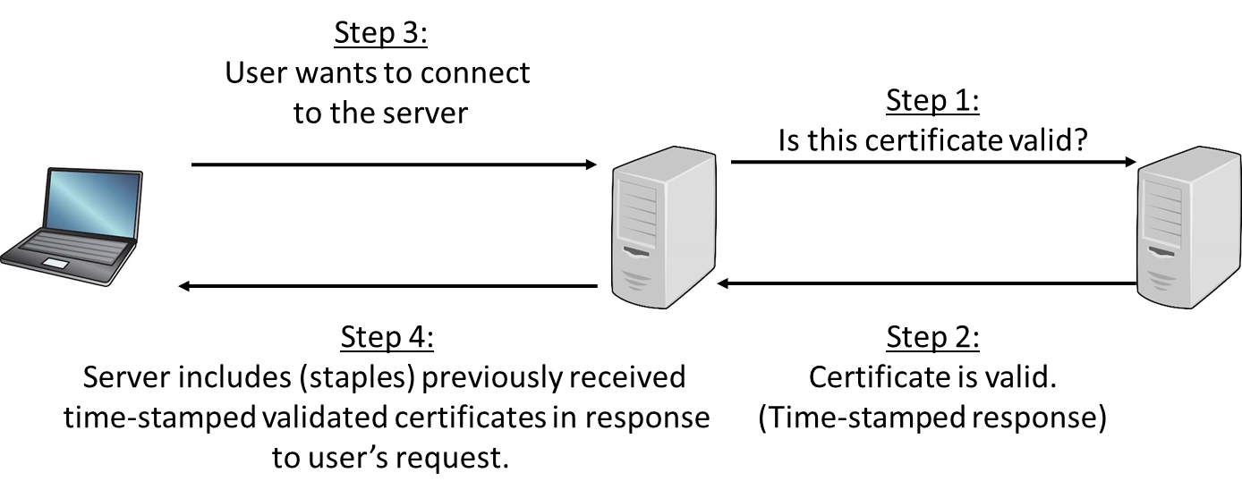
OCSP Stapling

Slide 55
Pinning
When a certificate is presented for a host, either identifying the host or providing a public key, this information can be saved in an act called pinning, which is the process of associating a host with a previously provided X.509 certificate or public key.
This can be important for mobile applications that move between networks frequently and are much more likely to be associated with hostile networks where levels of trust are low, and risks of malicious data are high.
Pinning assists in security through the avoidance of the use of DNS and its inherent risks when on less-than-secure networks.

Slide 56
Pinning
The process of reusing a certificate or public key is called key continuity.
This provides protection from an attacker, assuming that the attacker was not in position to attack on the initial pinning.
If an attacker is able to intercept and taint the initial contact, then the pinning will preserve the attack.
You should pin any time you want to be relatively certain of the remote host’s identity, relying on your home network security, and you are likely to be operating at a later time in a hostile environment.
If you choose to pin, you have two options: pin the certificate or pin the public key.

Slide 57
Trust Model
A trust model is a construct of systems, personnel, applications, protocols, technologies, and policies that work together to provide a certain level of protection.
All of these components can work together seamlessly within the same trust domain because they are known to the other components within the domain and are trusted to some degree.
Different trust domains are usually managed by different groups of administrators, have different security policies, and restrict outsiders from privileged access.

Slide 58
Trust Model
Most trust domains (whether individual companies or departments) need to communicate with other, less-trusted domains.
The trick is to figure out how much two different domains should trust each other as well as how to implement and configure an infrastructure that would allow these two domains to communicate in a way that will not allow security compromises or breaches.
Third-party CAs provide trust.

Slide 59
Trust Model
When two companies need to communicate using their individual PKIs, or if two departments within the same company use different CAs, two separate trust domains are involved.
The users and devices from these different trust domains will need to communicate with each other, and they will need to exchange certificates and public keys.
This means that trust anchors need to be identified, and a communication channel must be constructed and maintained.

Slide 60
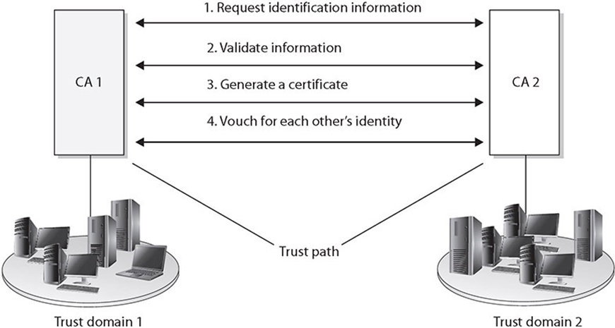
Trust Model
A trust relationship must be established between two issuing authorities (CAs).
This happens when one or both of the CAs issue a certificate for the other CA’s public key.

Slide 61
Hierarchical Trust Model
Basic hierarchical structure that contains a root CA, an intermediate CA, leaf CAs, and end-entities.
The root CA is the ultimate trust anchor for all other entities in this infrastructure, and it generates certificates for the intermediate CAs, which in turn generate certificates for the leaf CAs, and the leaf CAs generate certificates for the end-entities.

Slide 62
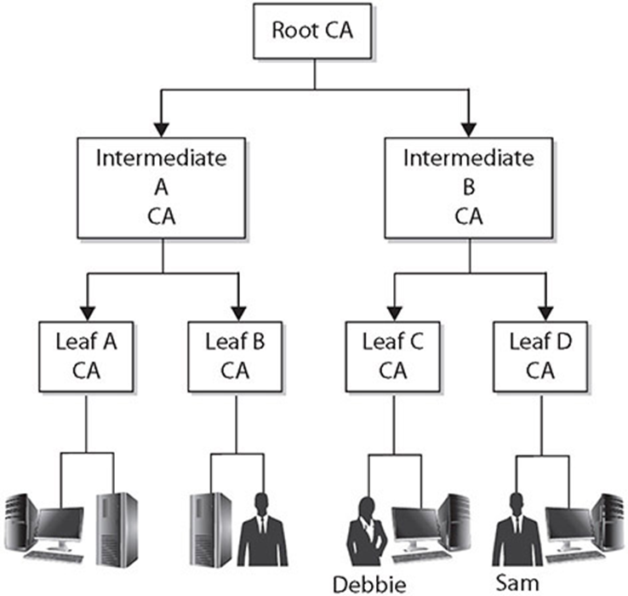
Hierarchical Trust Model

Slide 63
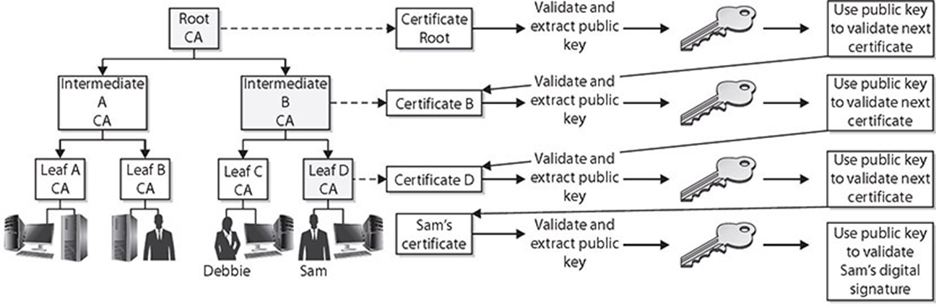
Hierarchical Trust Model
Walking the Certificate Path
When a user in one trust domain needs to communicate with another user in another trust domain, one user will need to validate the other’s certificate.
Each certificate for each CA, all the way up to a shared trusted anchor, also must be validated.

Slide 64
Peer-to-Peer Trust Model
In a peer-to-peer trust model, one CA is not subordinate to another CA, and no established trusted anchor between the CAs is involved.
The end-entities will look to their issuing CA as their trusted anchor, but the different CAs will not have a common anchor.
The two different CAs will certify the public key for each other, which creates a bidirectional trust. This is referred to as cross-certification since the CAs are not receiving their certificates and public keys from a superior CA, but instead are creating them for each other.
One of the main drawbacks to this model is scalability.
Each CA must certify every other CA that is participating, and a bidirectional trust path must be implemented.

Slide 65
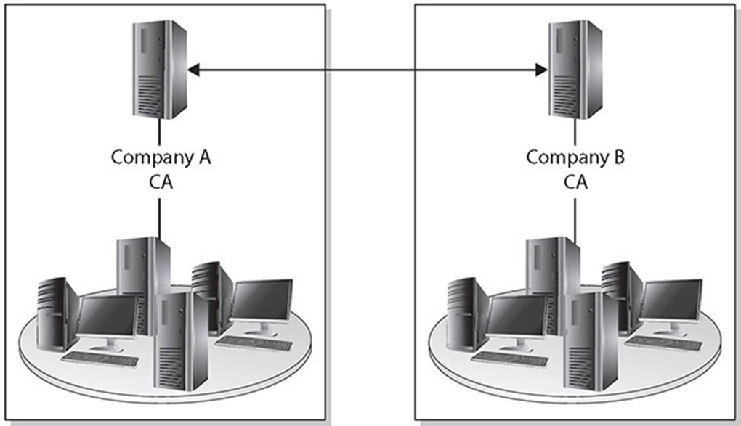
Peer-to-Peer Trust Model

Slide 66
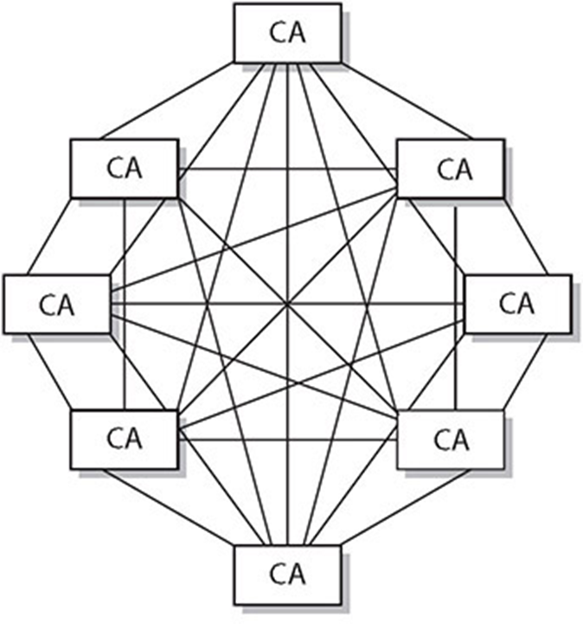
Cross Certification Model

Slide 67
Hybrid Trust Model
In a hybrid trust model, the two companies have their own internal hierarchical models and are connected through a peer-to-peer model using cross-certification.
Another option in this hybrid configuration is to implement a bridge CA.
The bridge CA is not considered a root or trust anchor, but merely the entity that generates and maintains the cross-certification for the connected environments.

Slide 68
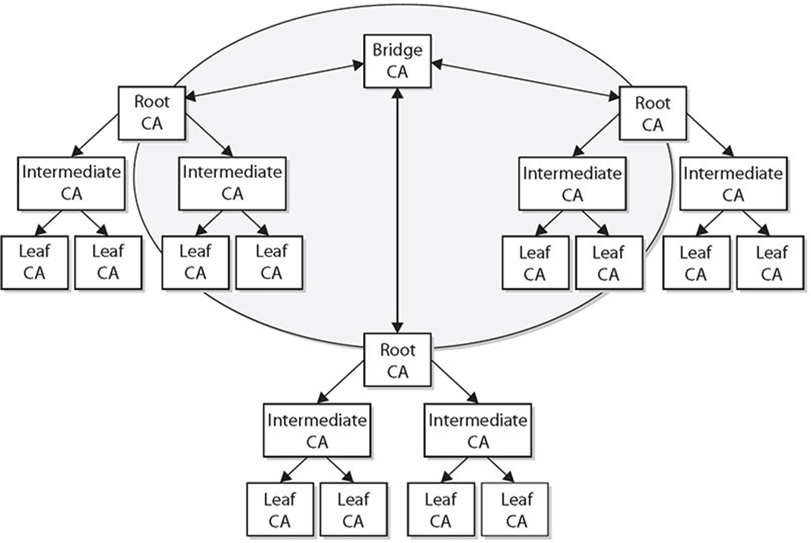
Hybrid Trust Model

Slide 69
Key Escrow
Key escrow is a system by which your private key is kept both by you and by a third party.
Key escrow in this circumstance is a system by which your private key is kept both by you and by the government.
This allows people with a court order to retrieve your private key to gain access to anything encrypted with your public key.
The data is essentially encrypted by your key and the government key, giving the government access to your plaintext data.

Slide 70
Key Escrow
Key escrow is also used by corporate enterprises, as it provides a method of obtaining a key in the event that the key holder is not available.
There are also key recovery mechanisms to do this, and the corporate policies will determine the appropriate manner in which to safeguard keys across the enterprise.
Key escrow can solve many problems resulting from an inaccessible key, and the nature of cryptography makes the access of the data impossible without the key.

Slide 71
Certificate Chaining
Why trust the certificate?
The answer lies in the certificate chain, a chain of trust from one certificate to another, based on signing by an issuer, until the chain ends with a certificate that the user trusts.
This conveys the trust from the trusted certificate to the certificate that is being used.
The signatures of all certificates in the chain must be verified up to the root CA certificate.

